Slide 1
HELLO! We Are
Robin
and
Habib

Slide 2
INVENTORY MANAGEMENT SYSTEM

Slide 3
WHAT IT DOES
Managing:
Inventory
Employee
Transaction

Slide 4
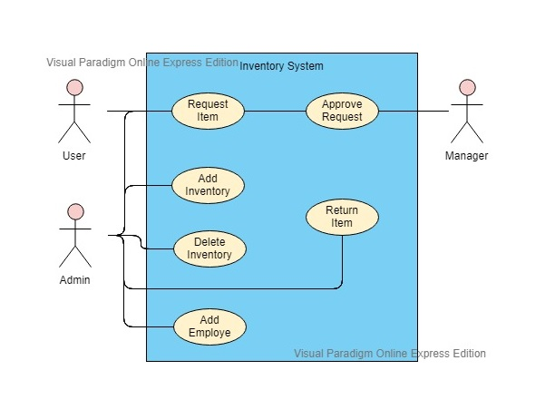
Use Case

Slide 5
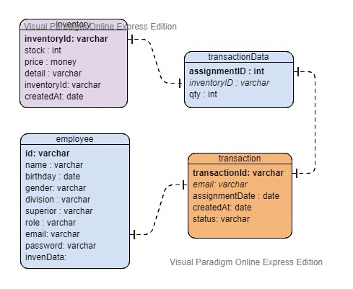
Database Structure

Slide 6
TECH-NOLOGY
Reactjs
Spring Boot
MongoDB

Slide 7
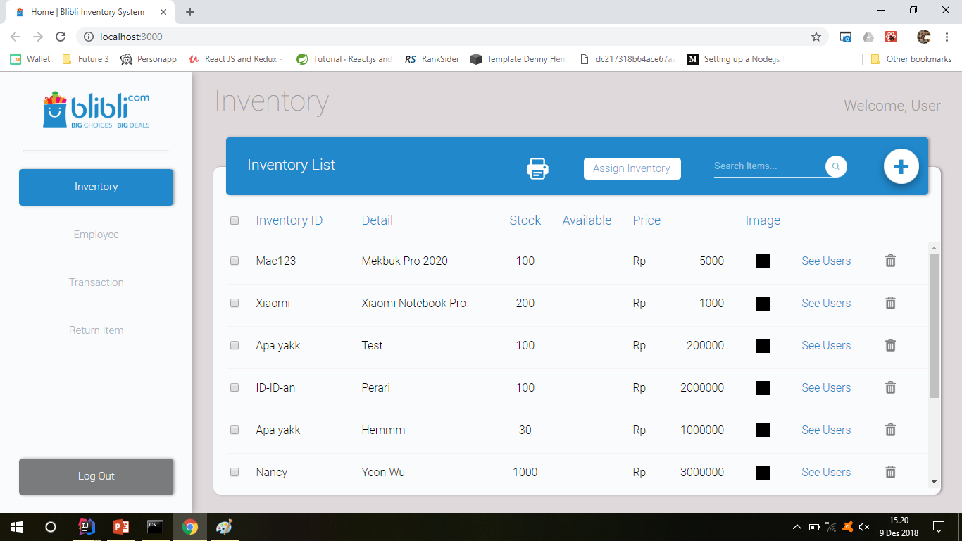
DEMO TIME
Place your screenshot here
Let’s see the application in action.

Slide 8
THA-NKS
Any questions?

Slide 9
TECHNOLOGY WE USE
Reactjs
Is one of the JavaScript framework that makes our code easier to manage.
Spring
Is the colour of the clear sky and the deep sea. It is located between violet and green on the optical spectrum.
Mongodb
Is the color of blood, and because of this it has historically been associated with sacrifice, danger and courage.

Slide 10
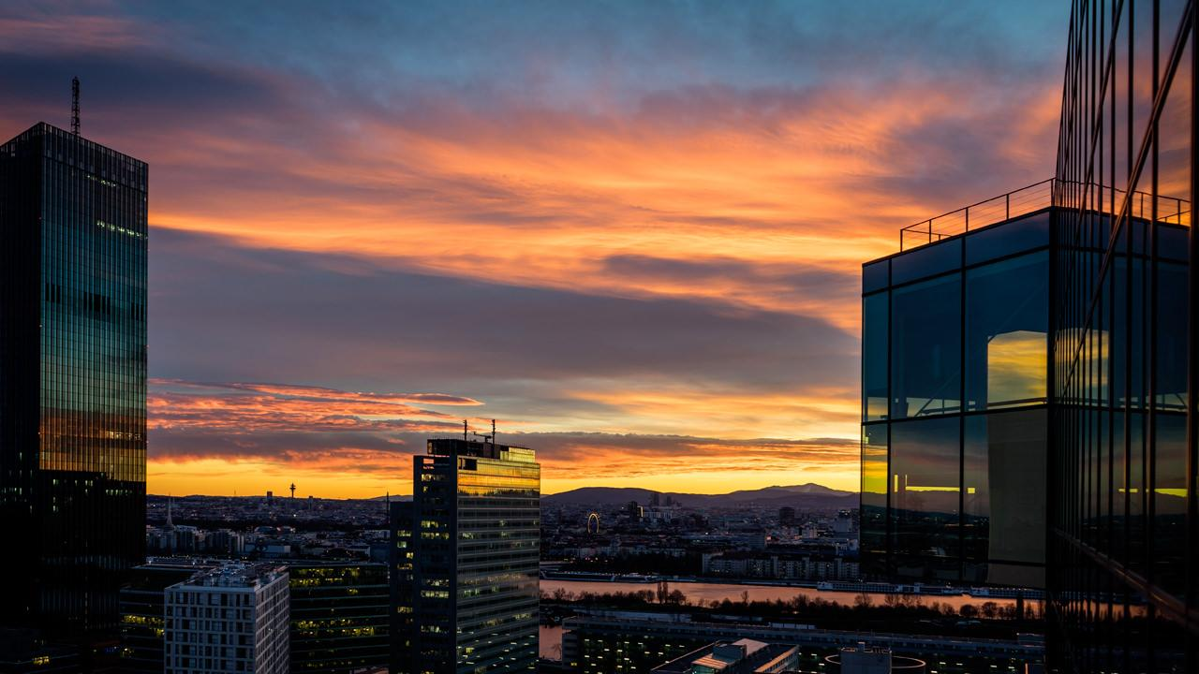
Want big impact?
USE BIG IMAGE.

Slide 11
TECHNOLOGY
Reactjs
Is one of the JavaScript framework that makes our code easier to manage.
Spring
Bla bla bla bla

Slide 12
MAIN MENU
Inventory
Employee
Transaction

Slide 13
INSTRUCTIONS FOR USE
EDIT IN GOOGLE SLIDES
Click on the button under the presentation preview that says "Use as Google Slides Theme".
You will get a copy of this document on your Google Drive and will be able to edit, add or delete slides.
You have to be signed in to your Google account.
EDIT IN POWERPOINT®
Click on the button under the presentation preview that says "Download as PowerPoint template". You will get a .pptx file that you can edit in PowerPoint.
Remember to download and install the fonts used in this presentation (you’ll find the links to the font files needed in the Presentation design slide)
More info on how to use this template at www.slidescarnival.com/help-use-presentation-template
This template is free to use under Creative Commons Attribution license. You can keep the Credits slide or mention SlidesCarnival and other resources used in a slide footer.

Slide 14
Quotations are commonly printed as a means of inspiration and to invoke philosophical thoughts from the reader.

Slide 15
USE CHARTS TO EXPLAIN YOUR IDEAS
Gray
White
Black

Slide 16
AND TABLES TO COMPARE DATA
 | A | B | C
Yellow | 10 | 20 | 7
Blue | 30 | 15 | 10
Orange | 5 | 24 | 16

Slide 17
MAPS
our office

Slide 18
89,526,124
Whoa! That’s a big number, aren’t you proud?

Slide 19
89,526,124$
185,244 users
100%
That’s a lot of money
And a lot of users
Total success!

Slide 20
OUR PROCESS IS EASY
first
last
second

Slide 21
LET’S REVIEW SOME CONCEPTS
Yellow
Is the color of gold, butter and ripe lemons. In the spectrum of visible light, yellow is found between green and orange.
Blue
Is the colour of the clear sky and the deep sea. It is located between violet and green on the optical spectrum.
Red
Is the color of blood, and because of this it has historically been associated with sacrifice, danger and courage.
Yellow
Is the color of gold, butter and ripe lemons. In the spectrum of visible light, yellow is found between green and orange.
Blue
Is the colour of the clear sky and the deep sea. It is located between violet and green on the optical spectrum.
Red
Is the color of blood, and because of this it has historically been associated with sacrifice, danger and courage.

Slide 22
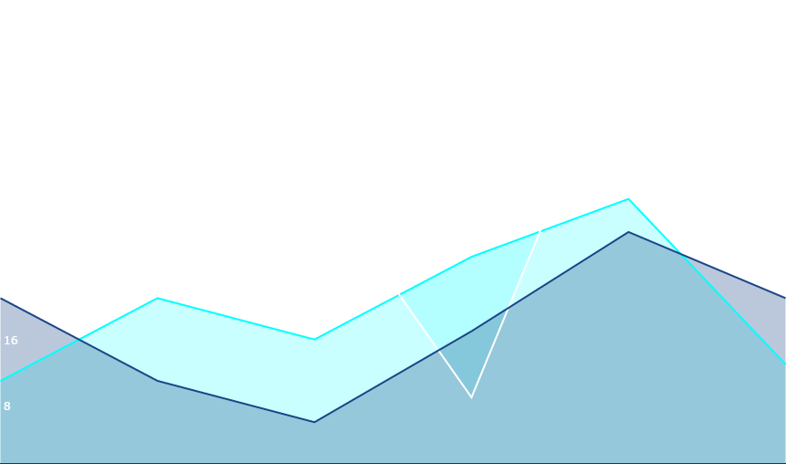
You can copy&paste graphs from Google Sheets

Slide 23
ANDROID PROJECT
Place your screenshot here
Show and explain your web, app or software projects using these gadget templates.

Slide 24
iPHONE PROJECT
Place your screenshot here
Show and explain your web, app or software projects using these gadget templates.

Slide 25
TABLET PROJECT
Place your screenshot here
Show and explain your web, app or software projects using these gadget templates.

Slide 26
CREDITS
Special thanks to all the people who made and released these awesome resources for free:
Presentation template by SlidesCarnival
Photographs by Unsplash

Slide 27
PRESENTATION DESIGN
This presentation uses the following typographies and colors:
Titles: Montserrat
Body copy: Raleway
You can download the fonts on these pages:
https://www.fontsquirrel.com/fonts/montserrat
https://www.fontsquirrel.com/fonts/raleway
Blue #6486db
You don’t need to keep this slide in your presentation. It’s only here to serve you as a design guide if you need to create new slides or download the fonts to edit the presentation in PowerPoint®

Slide 28
SlidesCarnival icons are editable shapes.
This means that you can:
Resize them without losing quality.
Change line color, width and style.
Isn’t that nice? :)
Examples:

Slide 29
😉
Now you can use any emoji as an icon!
And of course it resizes without losing quality and you can change the color.
How? Follow Google instructions https://twitter.com/googledocs/status/730087240156643328
✋👆👉👍👤👦👧👨👩👪💃🏃💑❤😂😉😋😒😭👶😸🐟🍒🍔💣📌📖🔨🎃🎈🎨🏈🏰🌏🔌🔑 and many more...

